Slide 2
WHAT IS A co-op?
PATRONAGE
Patronage: is the distribution of net returns to members based on their use of the co-op at the discretion of the board. Patronage is divided into two sections: Cash (Qualified Patronage) and Equity (Non-qualified patronage).

Slide 3
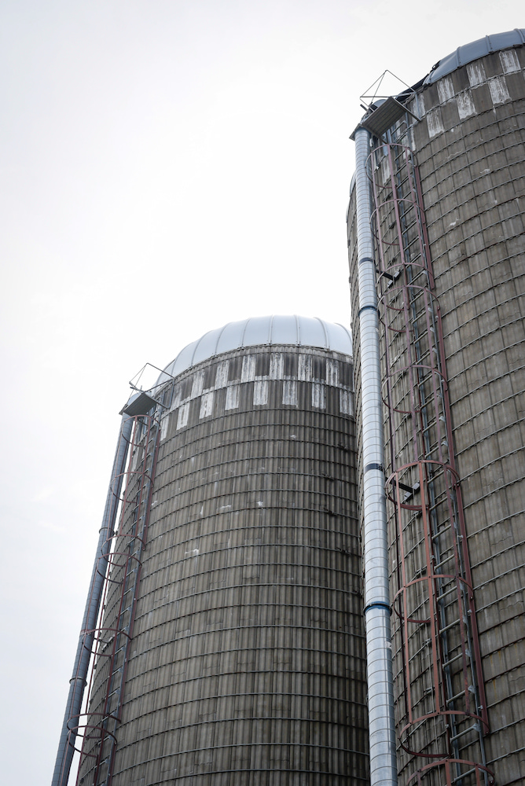
WHAT IS A CO-OP? | PATRONAGE
REVIEW
Patronage comes in the forms of cash payment and equity
Cash Payment: Qualified patronage is a dividend that is allocated as a cash payment and is taxable income for the member-owner
Equity: Non-Qualified patronage is a dividend that is allocated as equity and is tax-deferred for the member-owner

Slide 4
WHAT IS A CO-OP? | PATRONAGE
REVIEW
Patronage Pay out Rate Volume Sector Rate
Volume is measured in…
1. Dollars Spent
2. Gallons Purchased
3. Bushels Sold
Sector Rate: set by the cooperative’s board of directors.

Slide 5
WHAT IS A CO-OP? | PATRONAGE
DISCUSSION
How does patronage benefit the cooperative and its members?

